Slide 1

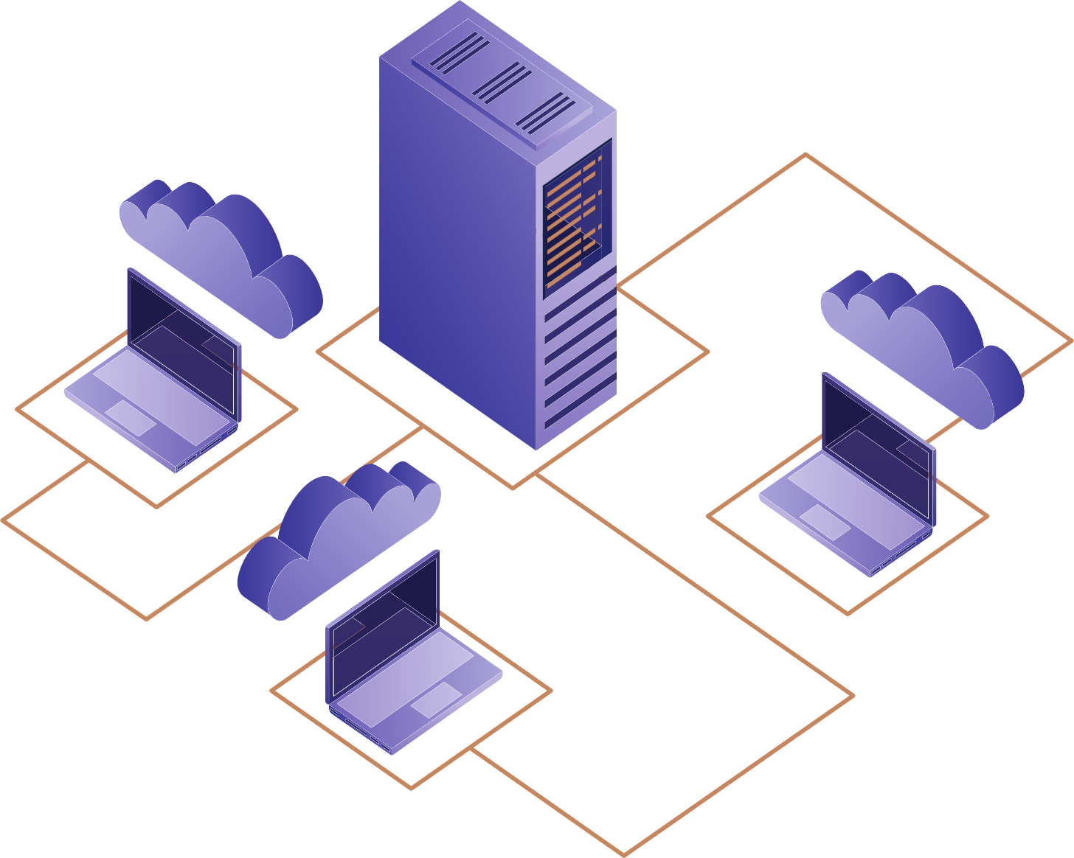



DevOps and AWS MasterClass
DEMO SESSION

Slide 2
Organization's Business Needs
Continuous Delivery
Higher Quality
Cost Optimization
Reduced Outages
Software Development Models
Plan

Slide 3
Software Development Models
Waterfall Model
Spiral Model
V - Model
Iterative and Incremental Models
RAD
Agile SDLC

Slide 4
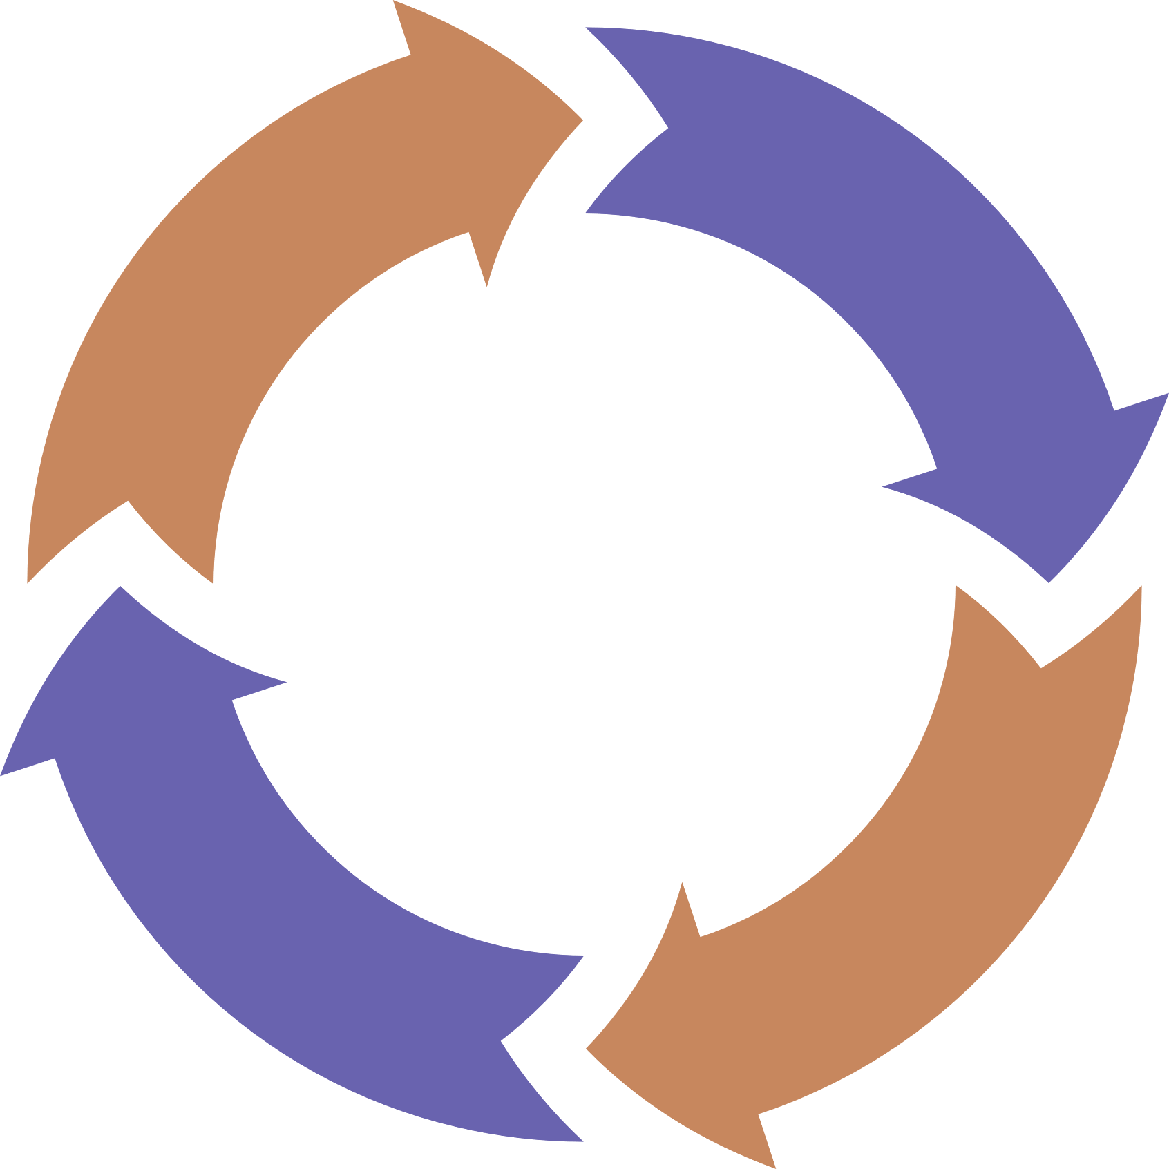
Traditional SDLC
Requirements Gathering
Analysis
Design
Code
Test
Implementation
Maintenance

Slide 5

Traditional SDLC - Challenges
Requirements change
Lack of involvement of customer/business
Accuracy of estimations
Schedule and cost overruns
Not much time left for testing or fix the defects etc.,
development
release

Slide 6
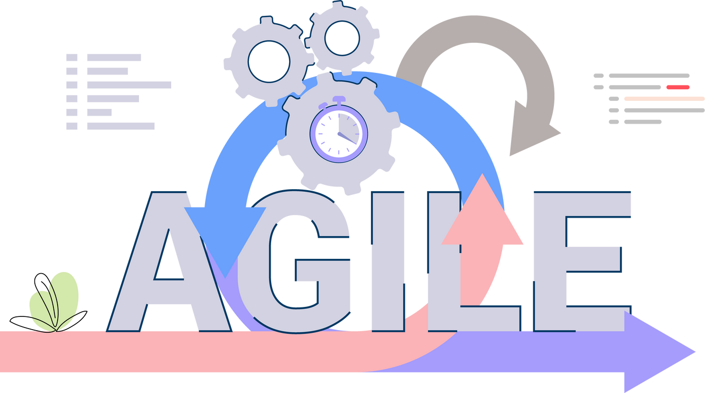
Agile SDLC
In simple terms : Agile : Incremental process of software development
Agile understands all the requirements can’t be collected in the beginning of project
Requirements can be changed or collected through the development cycle
Tests early and often, higher quality
Reduced risk and earlier software release

Slide 7
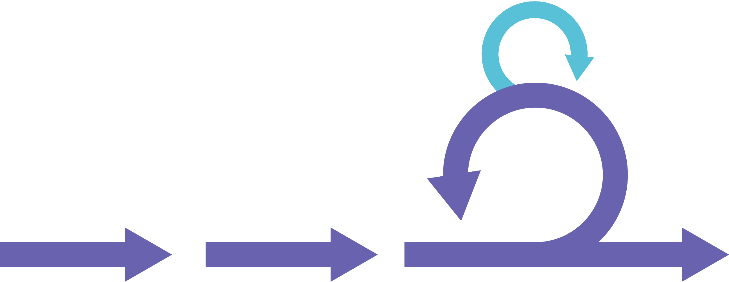
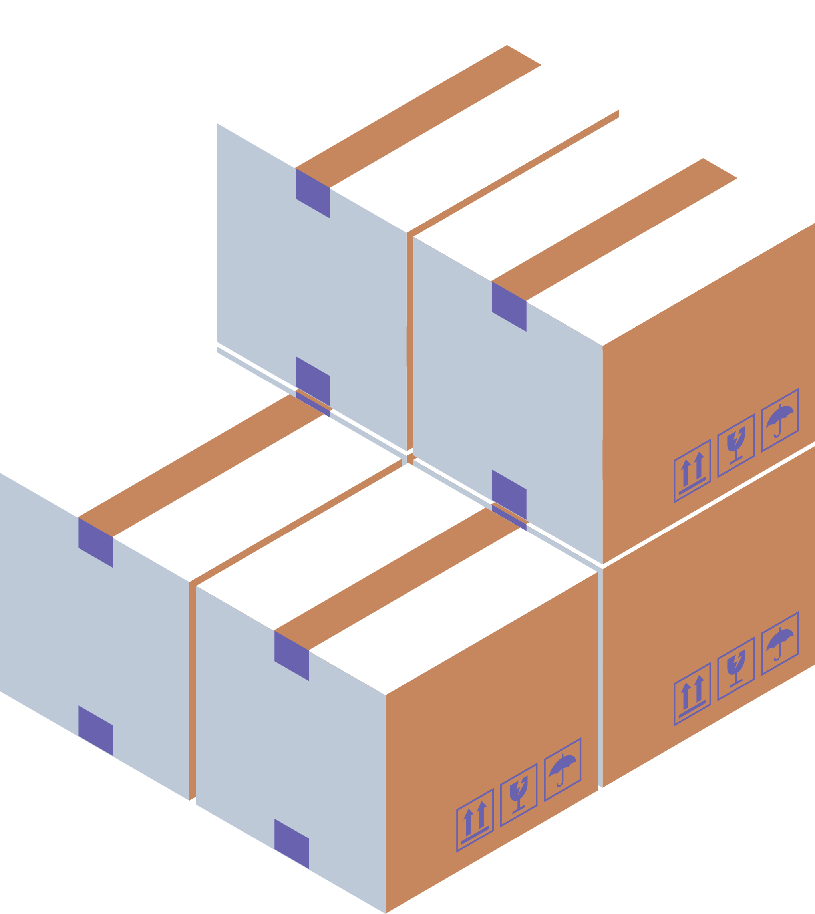
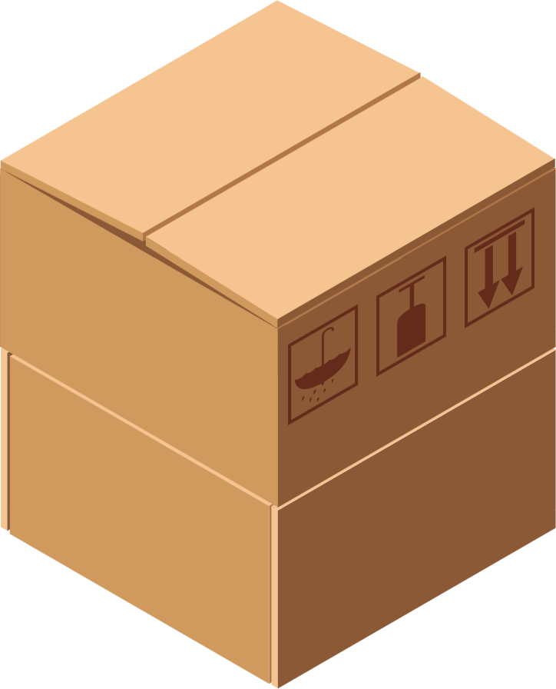
Agile SDLC - Motive
Releases ensuring Quality
In Incremental Fashion
plan-code-test-review
Release
sprint planning

Slide 8
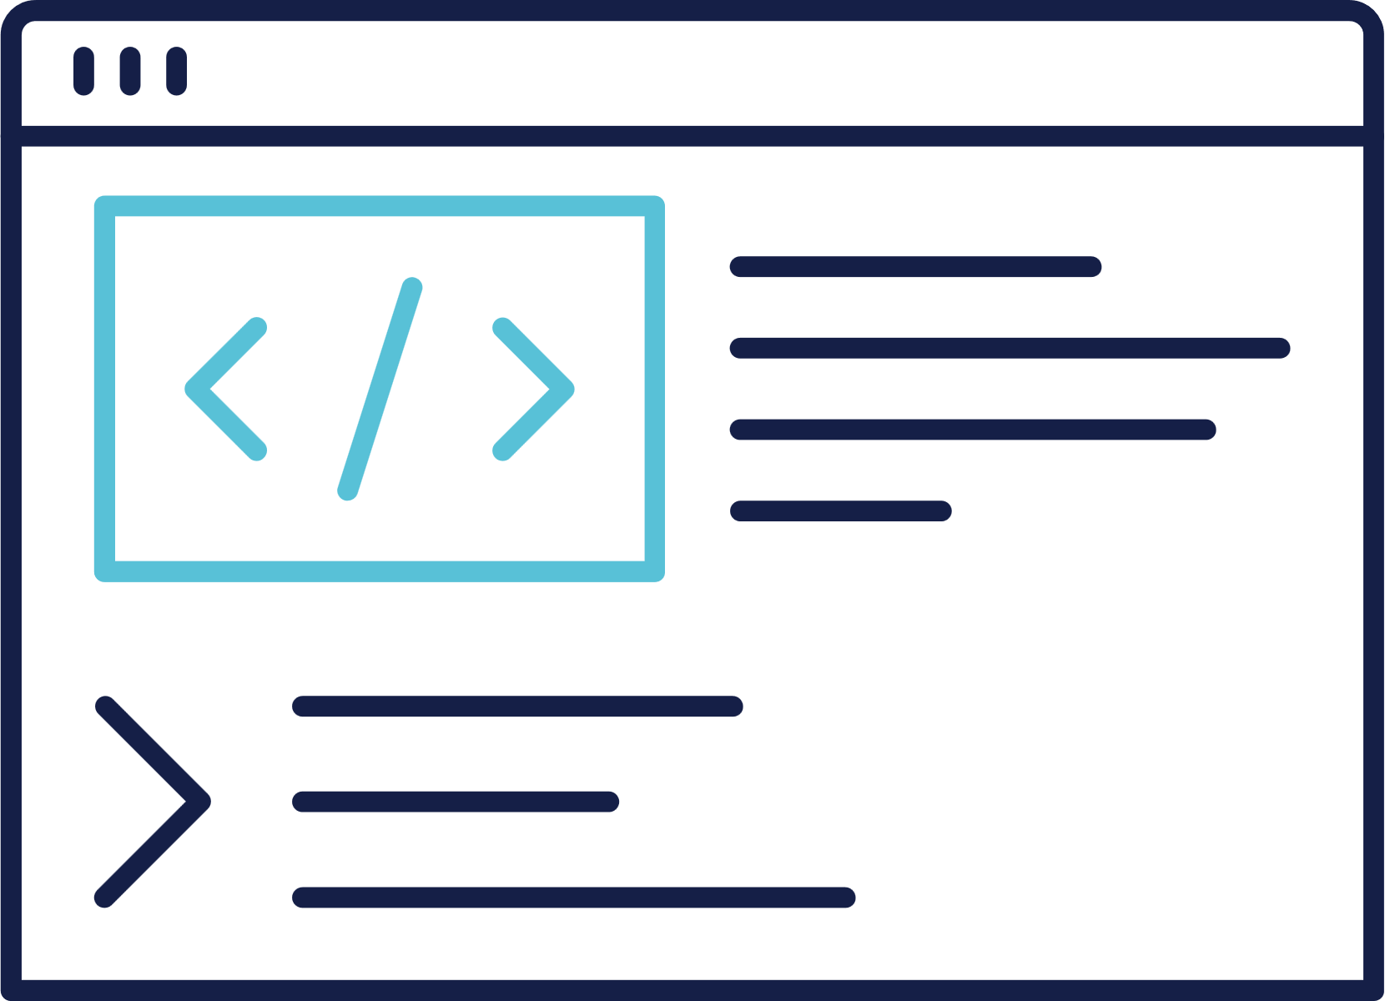
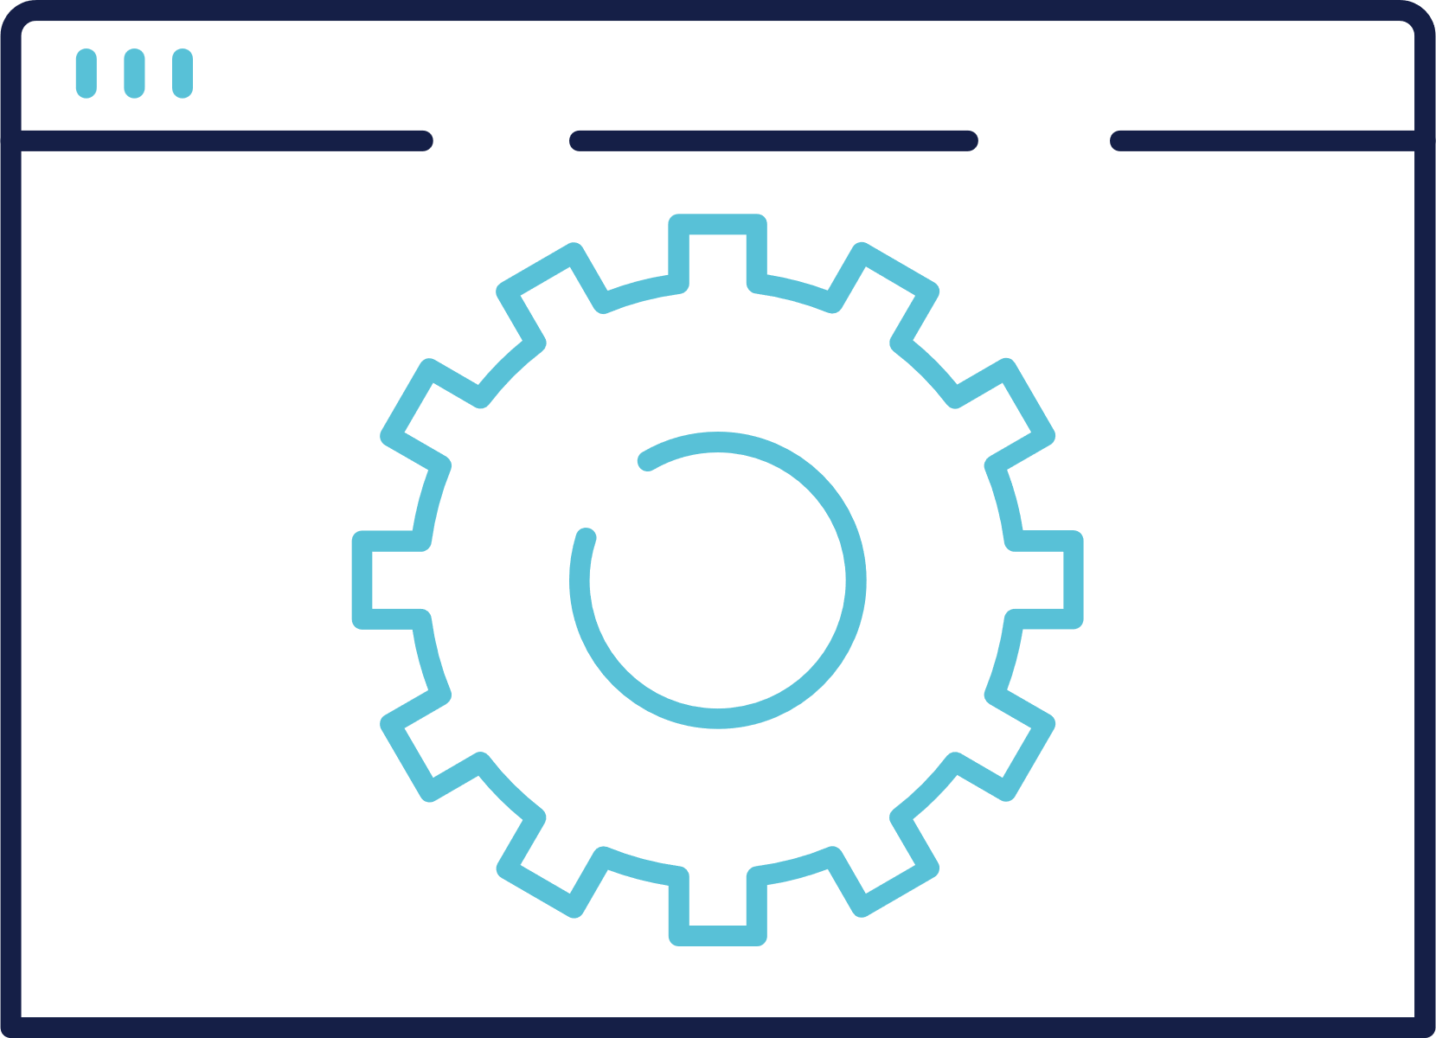
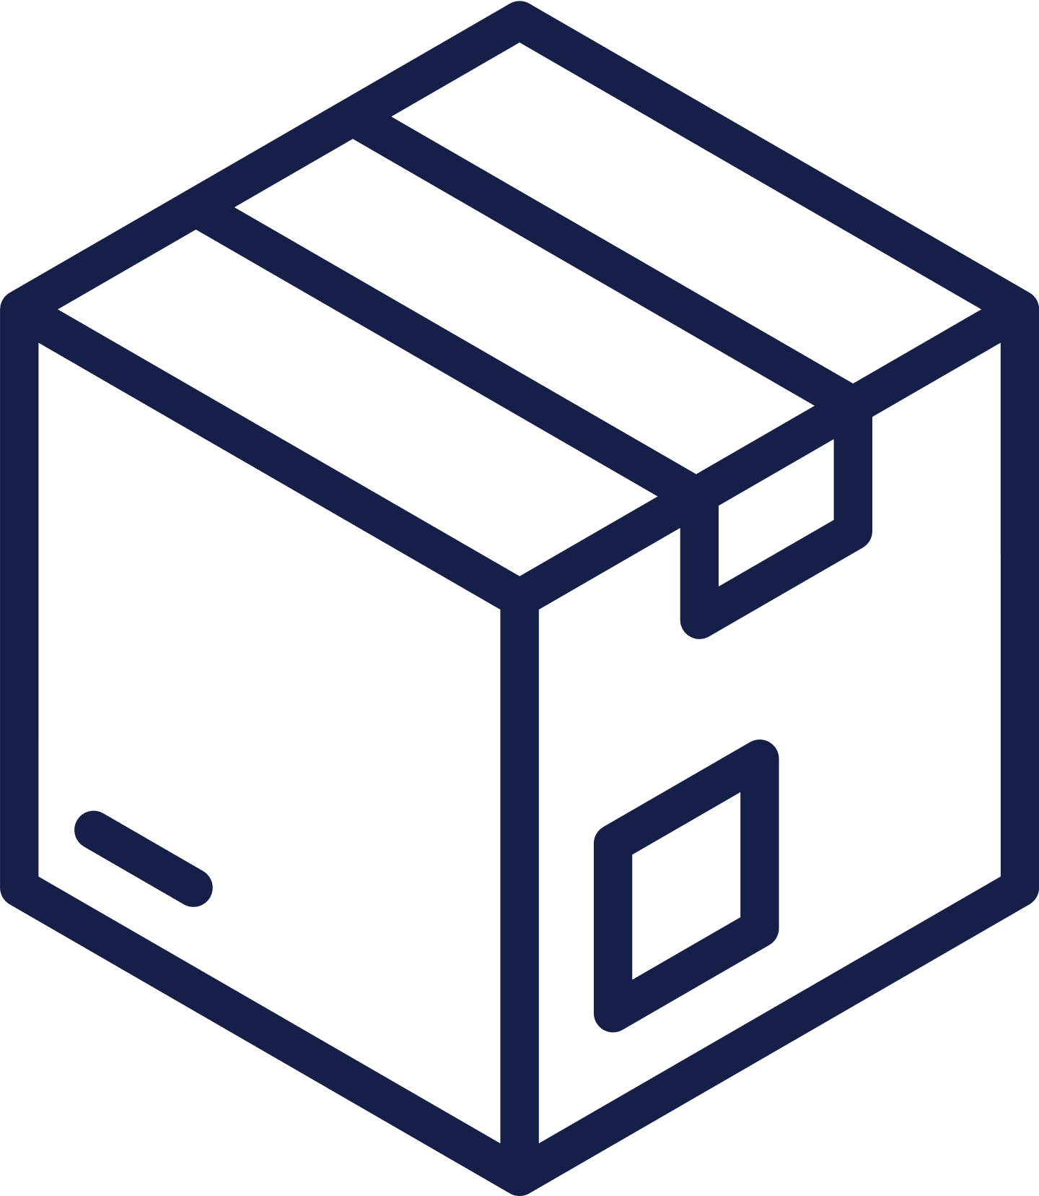
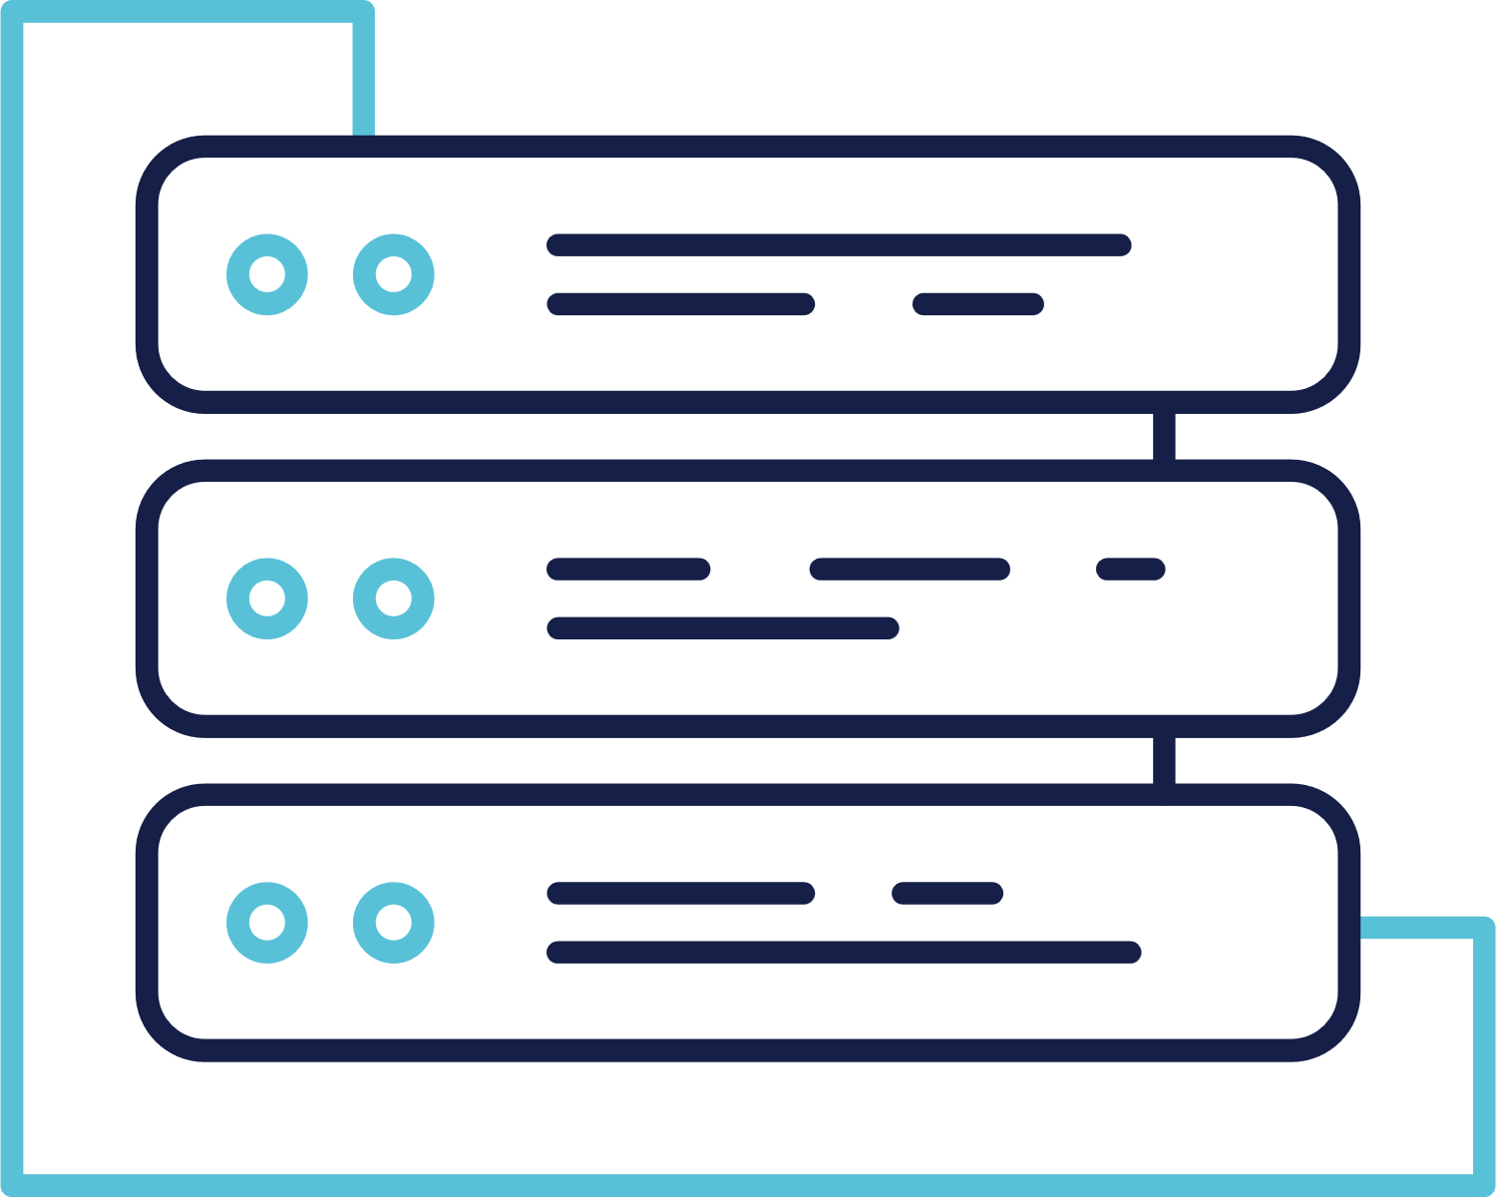
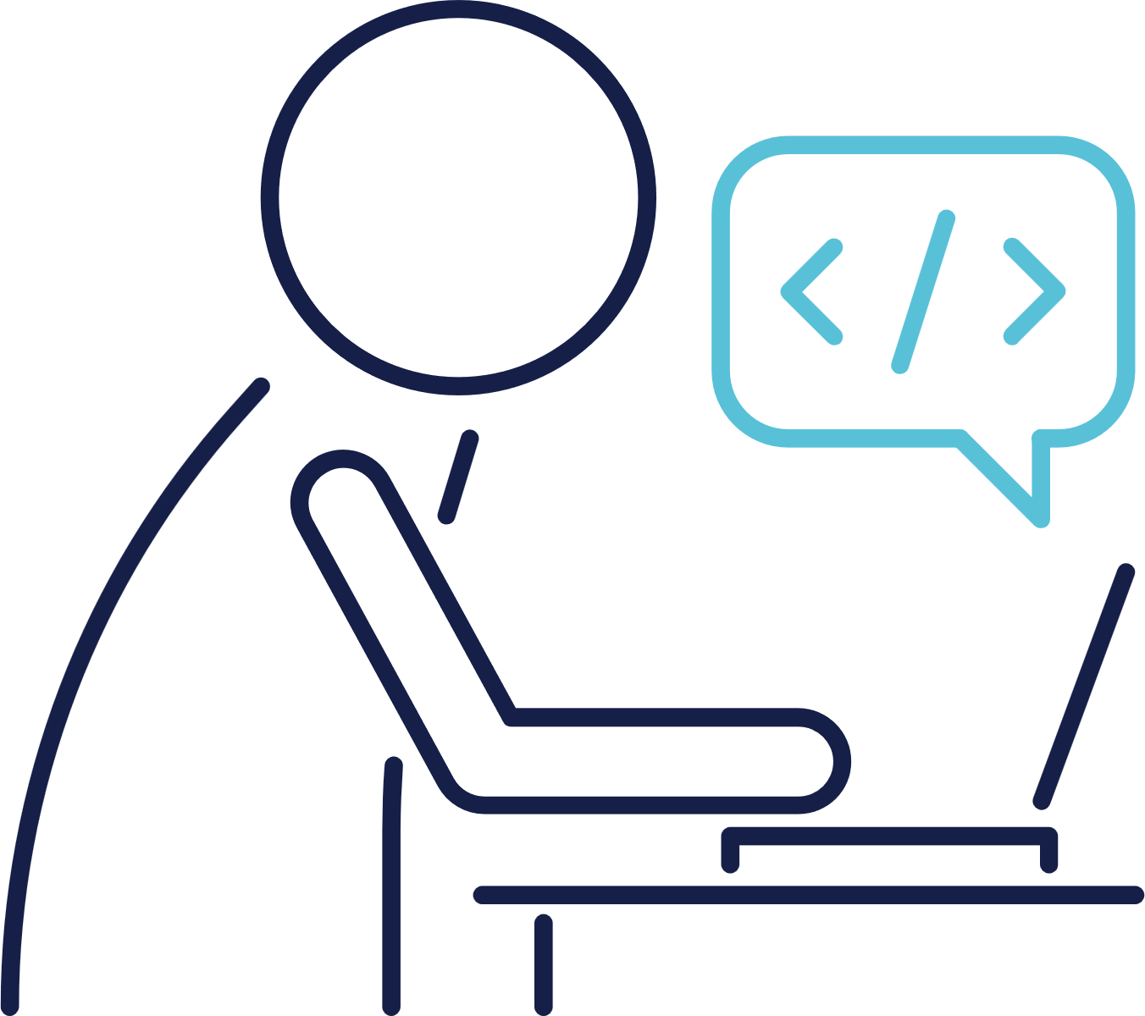
Development and Operations
Co-Ordination Issues
Developers
Front End
Back End
Test Team
Build Engineers
Release Managers
Perform tests on the application
Identify bugs, challenges
Perform Software Builds, Deploy the applications to various stages
Database Administration
Storage
Administration
System Administrators
Project Managers
Prepare the environment, Physical and cloud servers, configure them
Responsible for configuring the databases, Provide storage solutions etc.,
Presentations are communication tools that can be used reports.

Slide 9
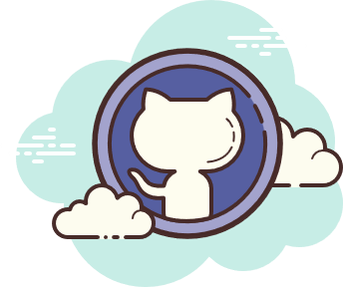


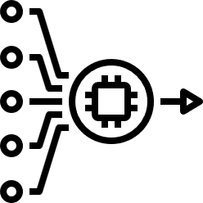
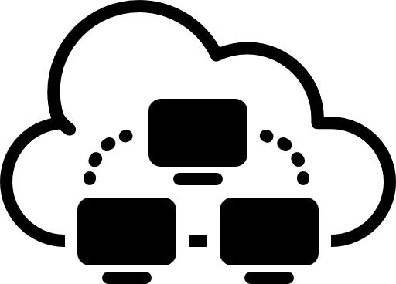


CO-ORDINATION
CHALLENGES
rawcode
VCS
git pull
artifact
build
BRE
Production
QA
SE
DevTeam

Slide 10


Development and QA
Environment Issues
app
app
java8
packages1.0
java17
packages5.0
IWOMM
Problem

Slide 11


Solution
Adapt DevOps Culture
DevOps is a set of practices that combines software development (Dev) and IT operations (Ops). It aims to shorten the systems development life cycle and provide continuous delivery with high software quality. DevOps is complementary with Agile software development; several DevOps aspects came from Agile methodology.

Slide 12

Solution
automation
collaboration
communication

Slide 13
DevOps Best Practices
Environment Issues
Continuous Development
Continuous Integration
Continuous Testing
Continuous Delivery
Security
Continuous Deployment
Infrastructure Automation
Configuration Management
Continuous Monitoring

Slide 14
DevOps Workflow
rawcode
GitHub
Cloud Native
Infra Automation
MSA
Docker Image
git pull
BuildServers
CI-Servers
Production
QA-Automation
DevTeam

Slide 15
DevOps Workflow
rawcode
GitHub
Cloud Native
Infra Automation
Project Management
Jira
Confluence
MSA
Docker Image
git pull
BuildServers
CI-Servers
Production
QA-Automation
DevTeam

Slide 16
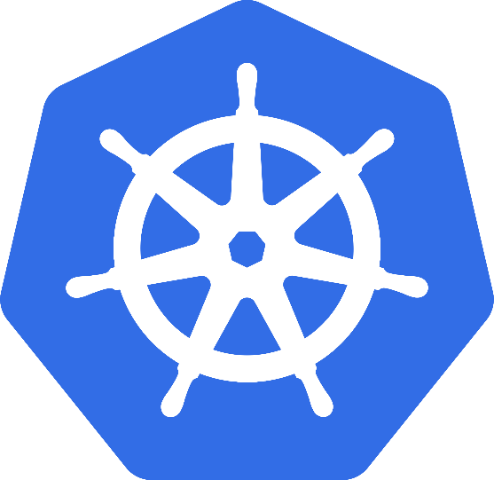
Container Orchestration
Kubernetes
Container orchestration is about managing the lifecycle of containers, particularly in large, dynamic environments. It automates the deployment, networking, scaling, and availability of containerized workloads and services. Running containers - which are lightweight and usually ephemeral by nature - in small numbers, is easy enough to be done manually. However, managing them at scale in production environments can be a significant challenge without the automation that container orchestration platforms offer. Kubernetes has become the standard for container orchestration in the enterprise world.
High Availability Failovers
Scalability Autoscaling
Load Balancing Disaster Recovery
Rolling Updates

Slide 17

Continuous Monitoring
Servers and applications
Prometheus Tool
for monitoring servers and applications
and take necessary actions as and when required

Slide 18
Tools Covered
Git and GitHub
SonarQube
Nexus
Tomcat
Jenkins
Docker
Ansible
Kubernetes
Terraform
AWS
Python
Shell Scripting
Linux
Jira
ArgoCD
Prometheus
Grafana

Slide 19
Thank You

